Slide 1

Used Car: Price Prediction

Slide 2
Problem Statement :-
The project data extracted from car 24 site of used car with help of selenium web scrapping techniques.
We have to predict price of used car based on present car features i.e. independent variable like how much old car ,fuel type ,car history brand etc.

Slide 3
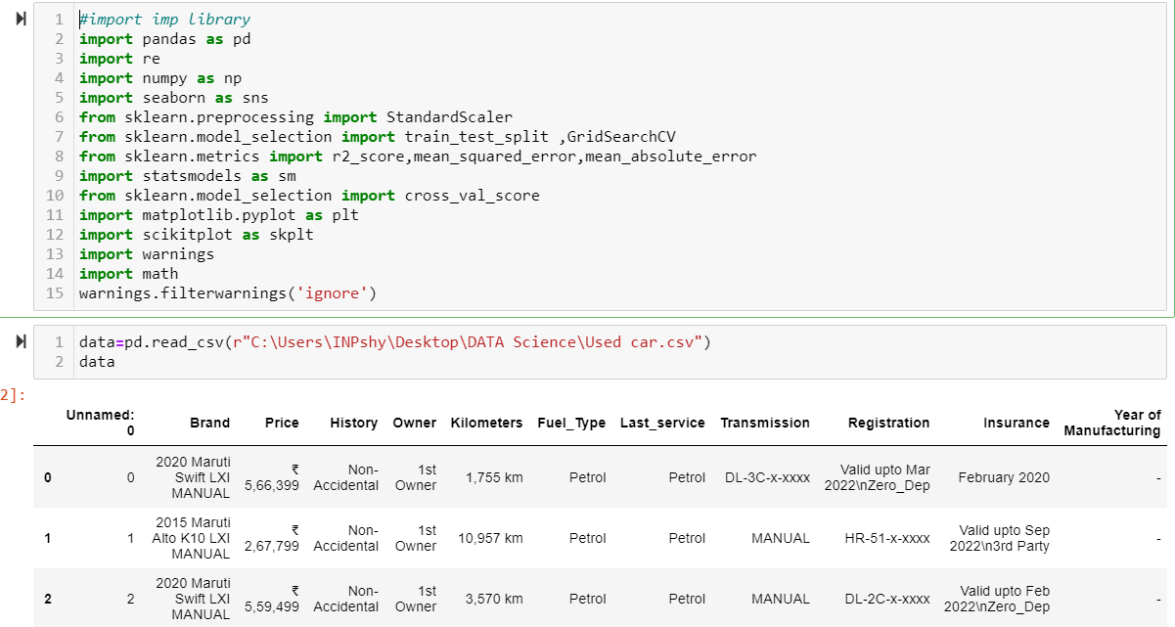
EDA(Exploratory data analysis )
First step to import library and import data file

Slide 4
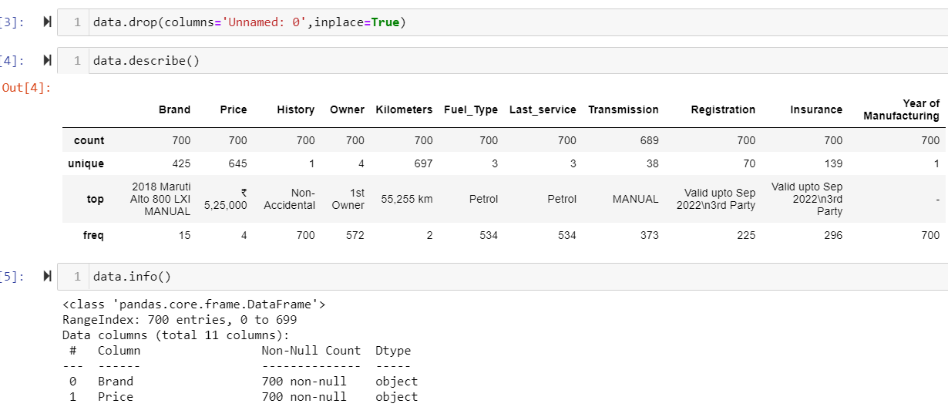
Data Types ,info and data cleaning

Slide 5
Data insight Analysis and cleaning
print(data.info()) give data information that how many object ,integer, float type data present in dataset.
Then I identified all data are object which need to convert in numerical values i.e Price and kilometres .
Other object data convert into numeric value by encoding ‘Brand’,’History’,’Fuel Type’,’Owner’, ‘Last Service’, ‘Transmission’, Registration,’Insurance’,
data.nunique() provide how many unique values present in dataset.
data.isnull().sum() to check any null values present in dataset. Year_of _manufacturing’ which have null values

Slide 6
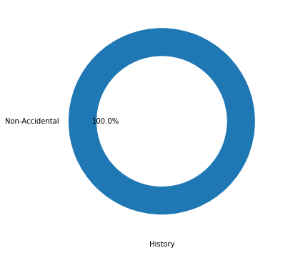
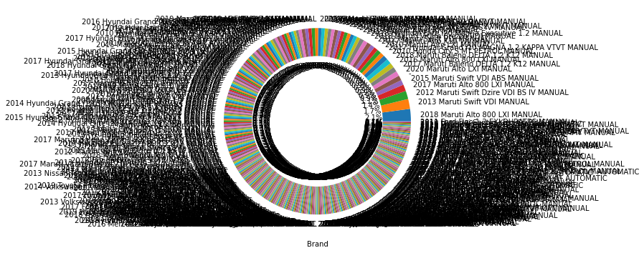
Pie Chart Analysis of object data “Brand” & “History”
As per pie chart it shows various car brand
History of all car shows Non accidential

Slide 7
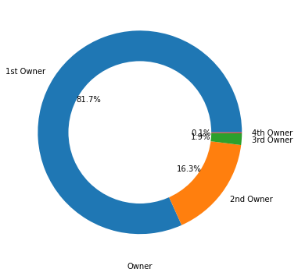
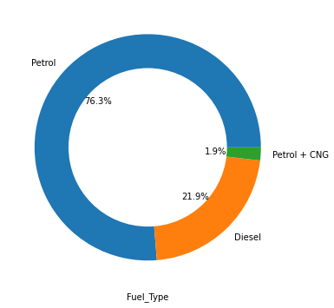
Owner & Fuel Type pie chart
Owner most of the car belongs to 1st Owner and very few belongs to 2nd Owner followed by 3rd and 4th owner
Fuel_Type petrol car is more than 76 % in market ,22% only Diesel car,CNG option of car is 2% that which may increase in coming year once infra of CNG develop as its clean and cheap energy source

Slide 8

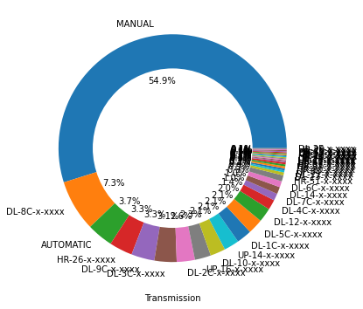
Masonry Veneer & ExterQual
Last service data reflects maximum car are petrol variant
Transmission line of car is 54% Manual car rest are automatic

Slide 9
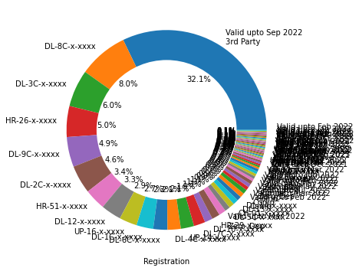
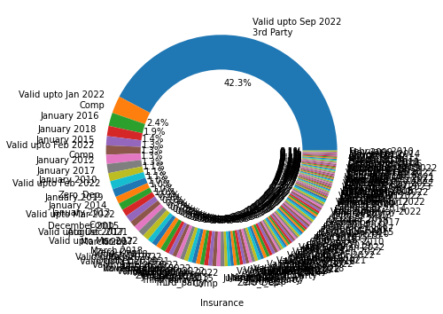
Registration & Insurance
Registration of car 3rd party 32% of the car, rest are DL & HR number
Insurance is also 3rd party and valid upto 22 as data is taken from year 2021

Slide 10
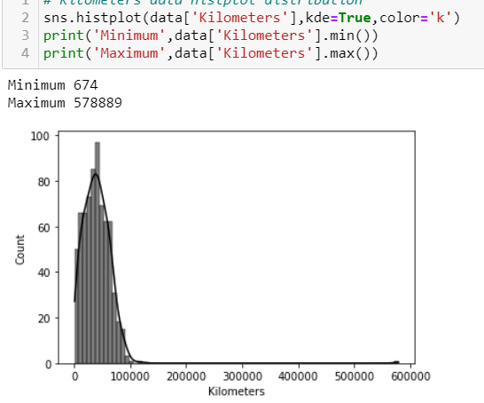
Kilometers Distribution plot(continuous data)
Kilometers range almost between 95,472 to 105763 km which seems flat but few car have 600000 km which right skwed data

Slide 11
Fill missing values & drop column
I observe that missing values in Year of manufacturing column, its happen because of web scrapping code not executed properly data is long and time consuming process so we proceed with available data .
So that we have drop the year_of manufacturing column data by drop method

Slide 12
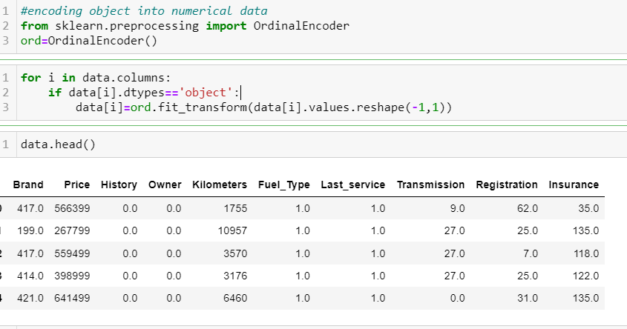
Encoding Categorical data
Encoding of categorical data into numerical values to build ML

Slide 13
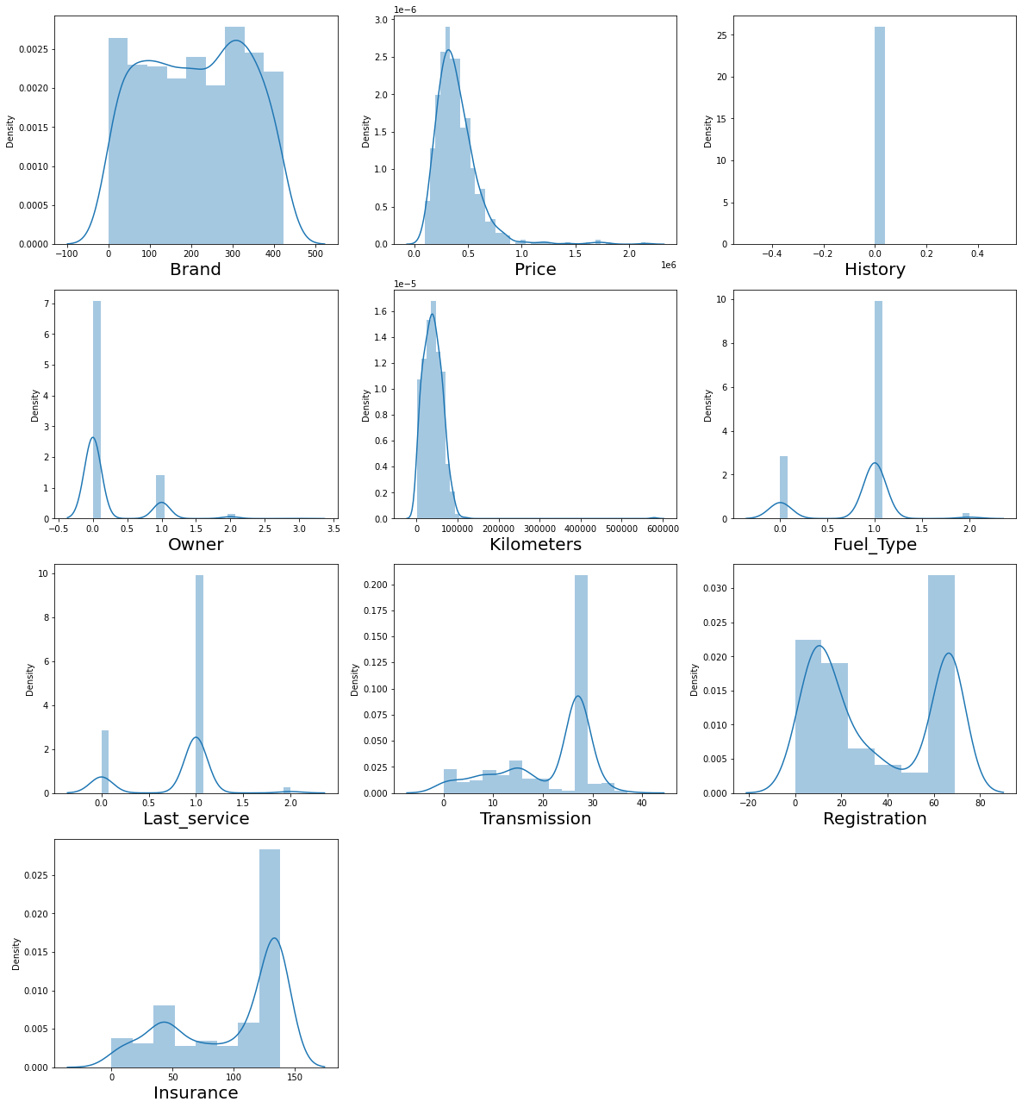
Distribution plot to get overview how data distributed
Brand ,history ,owner ,fuel type ,last service ,Transmission,
Registration,insurance are categorical data
continuous data kilometres right skewed,

Slide 14
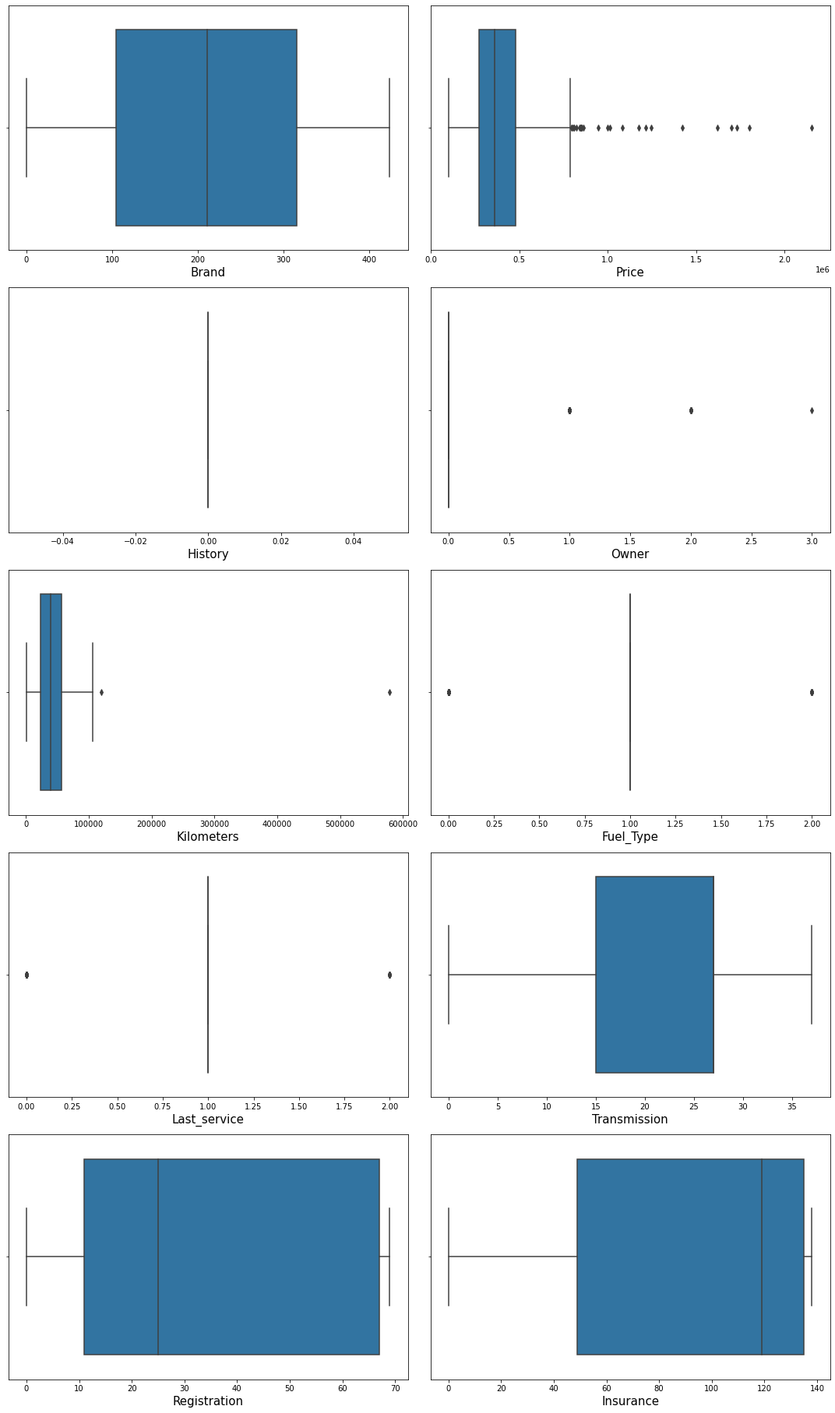
Boxplot of outliers present in dataset

Slide 15
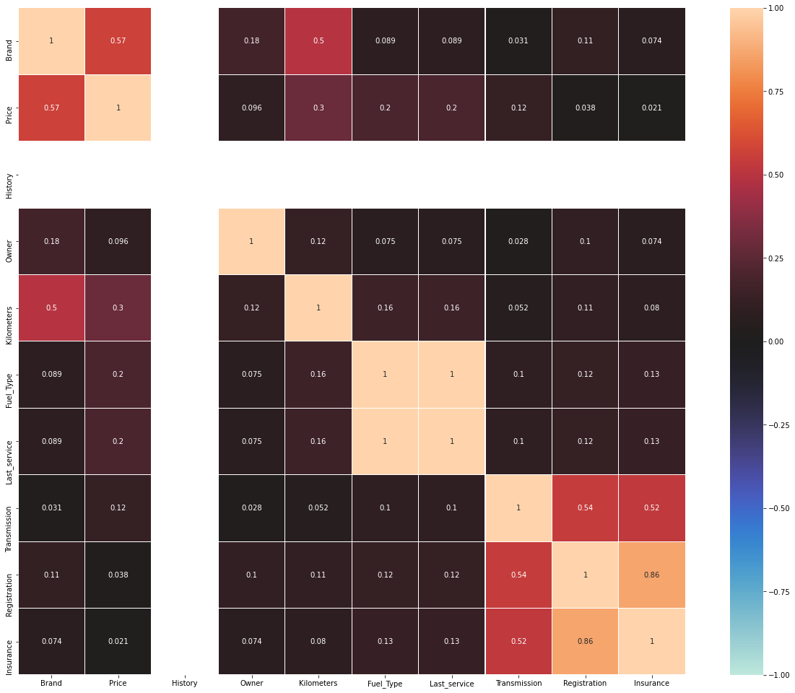
Heatmap to understand correlation between features dataset

Slide 16
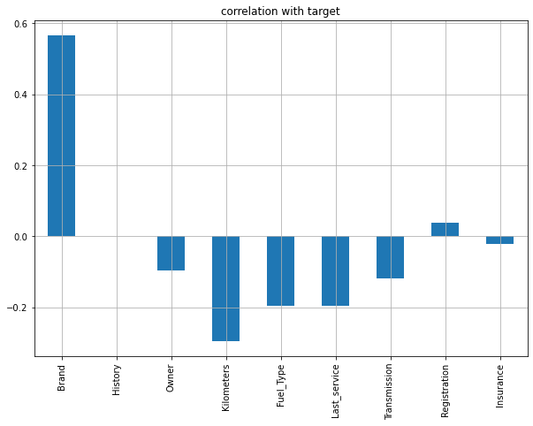
Correlation with target variable
Brand Registration
show strong positive relation
With target variable ,kilometres
Owner,Fuel Type,Last_service,
Transmission shows
Negative relation with target variable

Slide 17
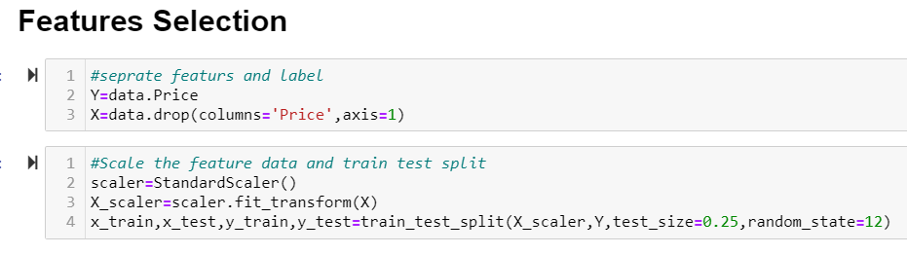
Features selection & Scale data & Train test split
Moving forward features selection of the data Features selection Y is target variable X is independent variable and scaling features and train test split

Slide 18
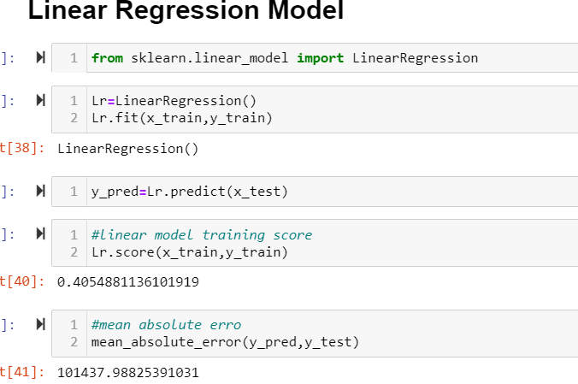
Linear Regression Model
Linear regression model import from sklearn library

Slide 19
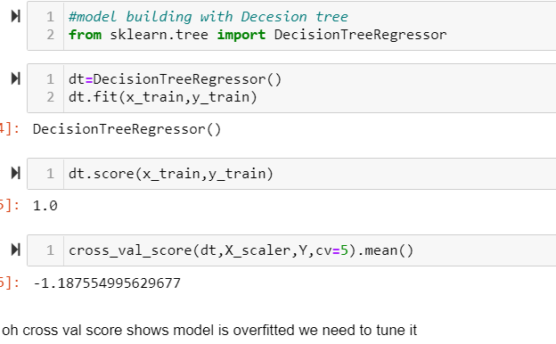
Decision Tree Regression
Decision tree regression model over fitted

Slide 20
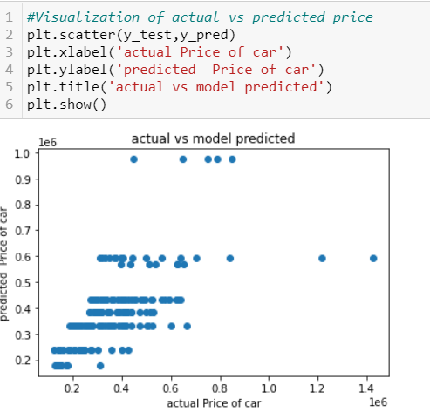
Post Tuning scatter plot predict vs actual price
Scatter plot actual vs predicted post tuning of Decision tree regression

Slide 21
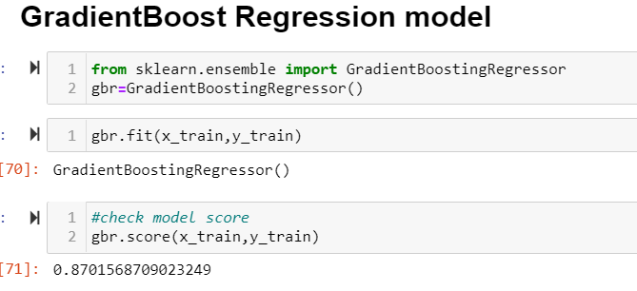
GradientBoost Regression Model
GradientBoost regression model score good among all

Slide 22
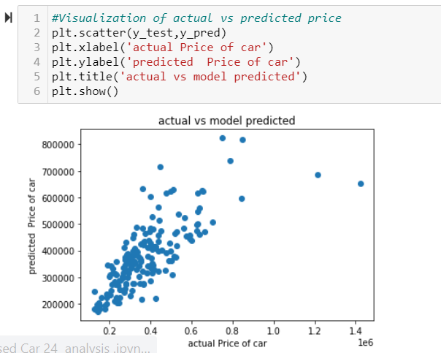
GradientBoosting Regression
Gradientboosting regression model post tuning model score is 87 % and cross val scor is 31% ,so model is s over fitted below graph reflect actual vs predicted used Car Price

Slide 23
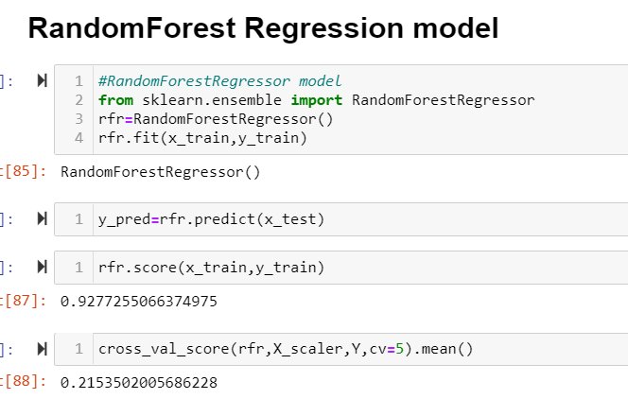
RandonForest Regression Model
Random forest model work on ensamble of decision trees ,usually trained with bagging method ,here model score is good but cv score is less, means model is over fitted

Slide 24
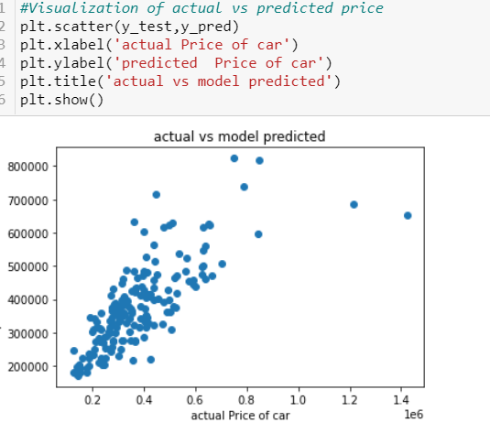
RandomForest Actual Vs Predicted Price Graph
Random forest regression model actual vs predicted graph with code

Slide 25
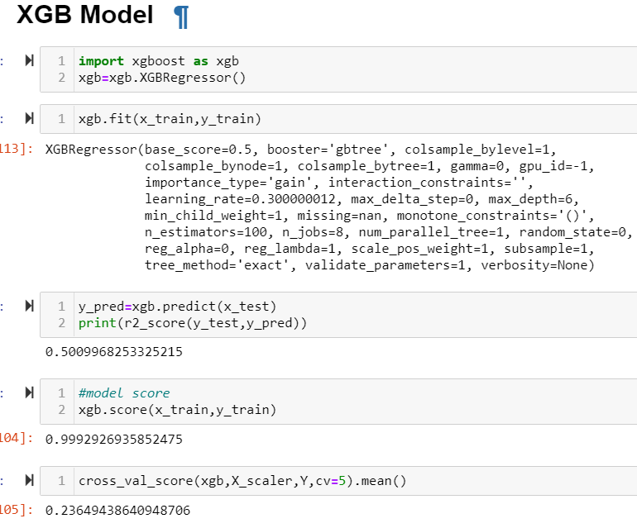
XGB Model
XGB Model with
Model score and
CV score

Slide 26
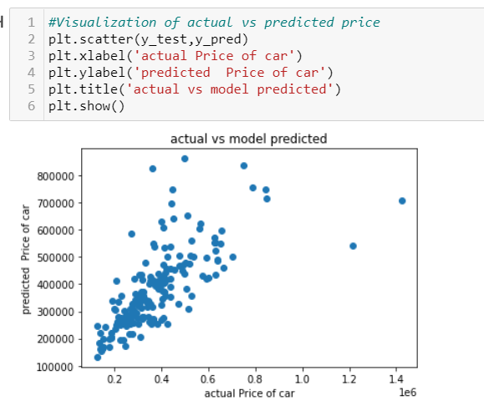
XGB Model
XGB model scatter plot of Actual Vs Predicted Used Car Price

Slide 27
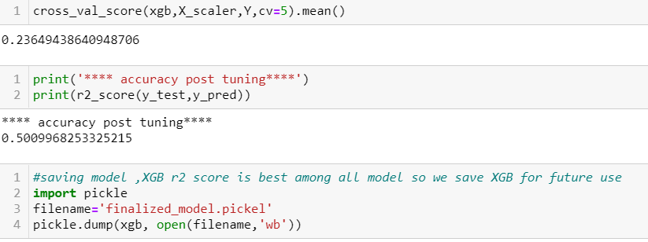
Final Best Model Saving
After analysing of various model I found best fitted model in terms of accuracy r2 score ,actual vs predicted graph , cross val score XBG regression model is best can save for future ,here model cv score and R2 score with model saving code mention

